Slide 1
Obstacle Avoidance for Ground Robot
Team 6 – ESW PeePs
Project 10
Date – 28 / 11 / 22
Team Members :
Mitansh Kayathwal
Vineeth Bhat
Chirag Jain
Pratham Priyank Thakkar

Slide 2
ProBlem Statement
The goal of this project is to build an autonomous robot that can avoid obstacles.
While moving forward, the robot will automatically detect obstacles and change its course to avoid them.
A web application will show the robot's current position and orientation in relation to its starting position. It also shows the number of obstacles detected versus time and the various directions taken by the robot.

Slide 3
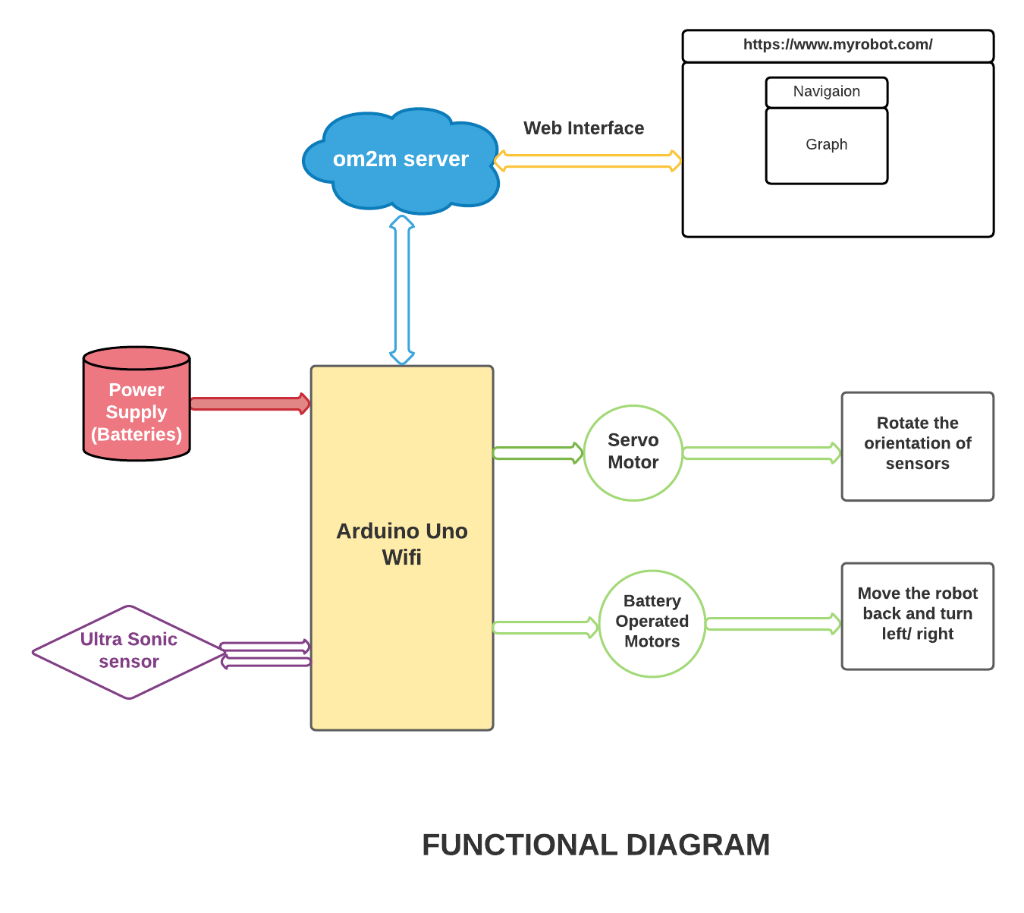
Functional Diagram

Slide 4
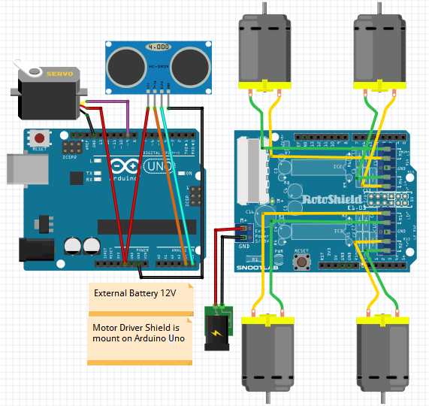
Circuit Diagram

Slide 5
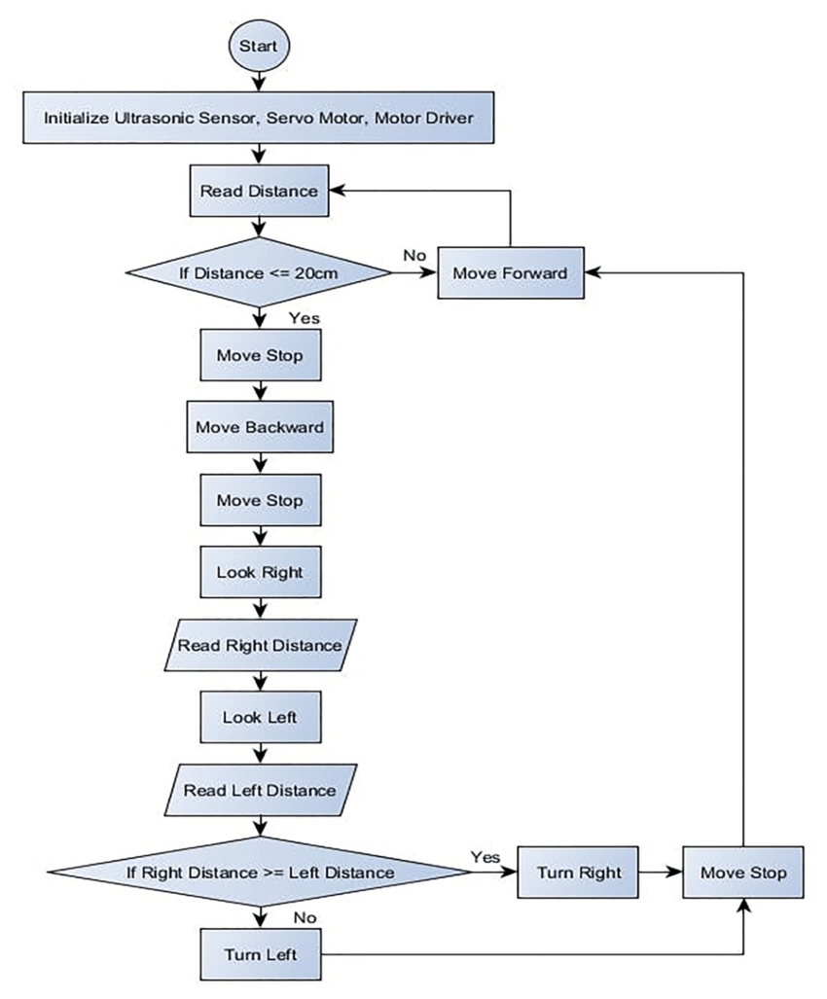
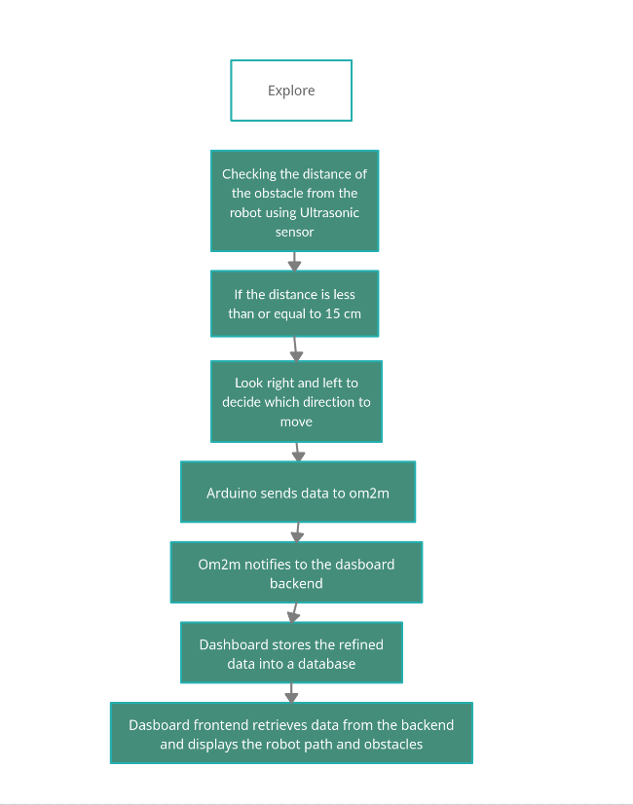
FLoW CHART

Slide 6
Obstacle Detection
The robot advances until it "sees" an obstacle as it explores a space.
The ultrasonic sensor turns right and left using servo motor after detecting an obstacle to measure the distances on both sides.
After comparing the two distances, the algorithm proceeds in the direction that results in the greater distance.
Further, the robot probes it’s surroundings every 5 seconds for slanted surfaces.
By using this technique, a robot's surrounding area is defined.
For robot navigation that avoids collision, a band of these spaces can be formed.

Slide 7
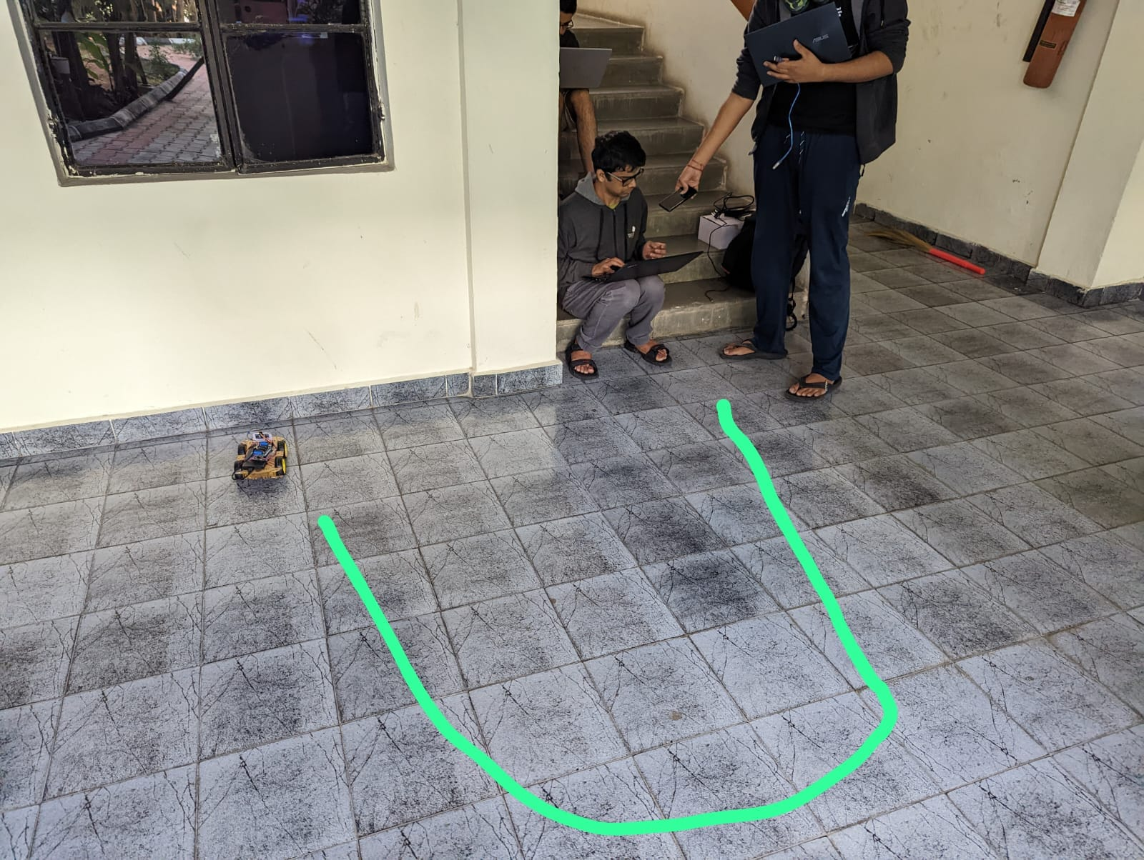

Slide 8
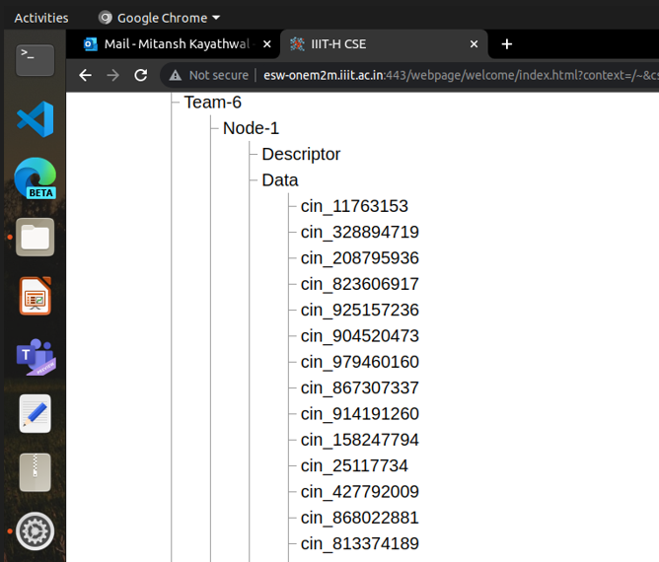
ONE M2m
The resource tree structure of the om2m is given as follows :
Team – 6 (Application Entity)
Node – 1 (Container)
Descriptor(Container)
Data(Container)
Data(Container instance)

Slide 9
One m2m(continue)
When the robot encounters a collision and rotates to avoid it, it sends data to the om2m server.
This is done primarily to reduce network overhead and the om2m maximum number of instances.
Each data instance is an string with space as delimiter of the following format :
[ x , y , time ]
Also we are using the https protocol for communication to ensure security

Slide 10
DASHboard
The dashboard shows us a visual representation of the robot's navigation by plotting its current location and providing other useful data, such as the number of obstacles the robot has encountered and the various turns it has made.
The dashboard also offers a users specific interface.
The dashboard is made up of a front end that runs in the user's browser and a back end that runs on a centralised server.
The om2m server notifies the backend with the raw data.
To determine the coordinates of the robot's position, the backend processes the raw data.
Then the backend provides this processed data to the frontend.

Slide 11
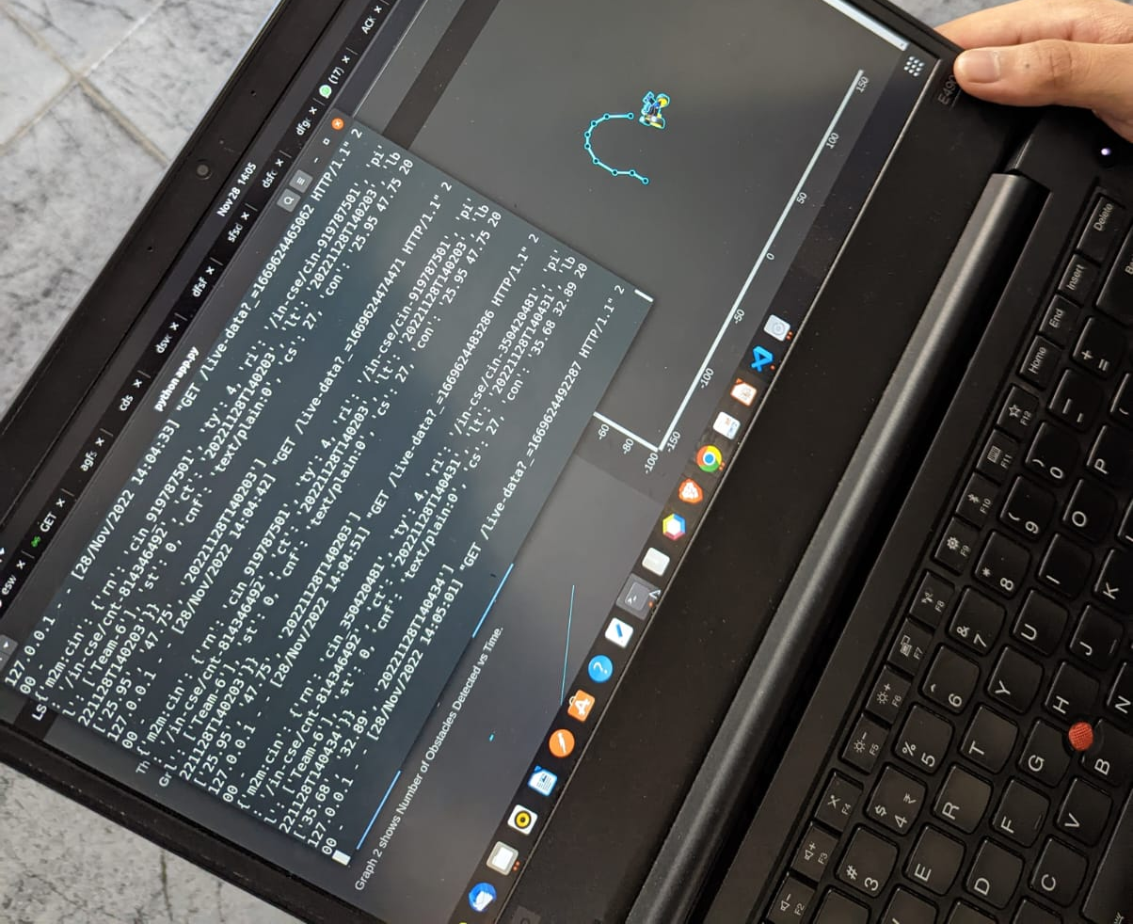

Slide 12
Challenges FACED
Hardware difficulties
WiFi connection problems with Arduino Uno rev 2
We also sent data to MongoDB to ensure that we have extra copies of the data in case of crashes (e.g. crash in OneM2M) so as to avoid single point failure but had to scrape the complete work because Arduino Uno Rev 2 wasn’t able to connect properly.

Slide 13
Timeline
28 –September decided the project
5 Oct received components
Till 15 Oct Assembled Hardware and tested all components
Till 22 Oct checked our obstacle avoidance algorithm
Till 30 Oct Integrated thingspeak and made backend
Completed frontend and integrated OM2M before endsem

Slide 14
THANK YOu
Team 6 :
Vineeth Bhat (2021101103)
Chirag Jain (2021101100)
Mitansh Kayathwal (2021101020)
Pratham Thakkar (2021101077)

